Slide 1
Capstone Engagement
Assessment, Analysis, and Hardening of a Vulnerable System

Slide 2
Table of Contents
This document contains the following sections:
01
Network Topology
02
Red Team: Security Assessment
03
Blue Team: Log Analysis and Attack Characterization
Hardening: Proposed Alarms and Mitigation Strategies
04

Slide 3
Network Topology
‹#›

Slide 4
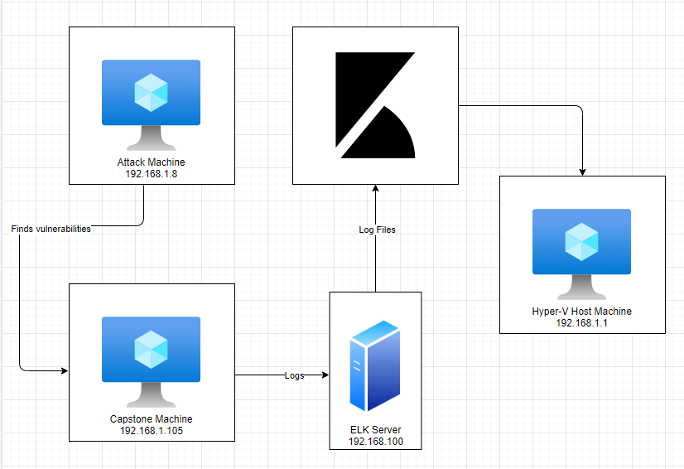
Network Topology
Network
Address Range: 192.168.1.0/24
Netmask: 255.255.255.0
Gateway: 10.0.0.76
Machines
IPv4: 192.168.1.1
OS: Windows 10
Hostname:
Azure Hyper-V ML-REFVM-684427
IPv4: 192.168.1.90
OS: Linux
Hostname: Kali
IPv4: 192.168.1.100
OS: Linux
Hostname: ELK Stack
IPv4: 192.168.1.105
OS: Linux
Hostname: Capstone

Slide 5

Red Team
Security Assessment
‹#›

Slide 6
Recon: Describing the Target
Nmap identified the following hosts on the network:
Hostname | IP Address | Role on Network
Azure Hyper-V ML-REFVM-684427 | 192.168.1.1 | Host Machine
Kali | 192.168.1.90 | Attack Machine
Capstone | 192.168.1.105 | Target Machine
ELK Stack | 192.168.1.100 | Kibana machine for network monitoring & analysis

Slide 7
Vulnerability Assessment
The assessment uncovered the following critical vulnerabilities in the target:
Vulnerability | Description | Impact
Open Web Port CVE-2019-6579 | Port 80 is commonly used for web communication and if left open and unsecure, it can allow public access. | This vulnerability allows access to confidential files and folders.
LFI | LFI allows access into confidential files on a site. | An LFI vulnerability allows attackers to gain access to sensitive credentials.
Hashed Password | Unsalted passwords can be easily cracked with resources (i.e., crackstation.net, John the Ripper, etc.) | Hackers only need the username and password. Once the password is cracked and they have the username, they will have access into the system.
Simple Usernames | Short names, first name, or any simple combination. | Usernames like Ashton, Ryan, and Hannah are all simple usernames that can be easily obtained.

Slide 8
Vulnerability Assessment
The assessment uncovered the following critical vulnerabilities in the target:
Vulnerability | Description | Impact
Weak Password | Short, common, simple, or non-complex passwords. | Weak passwords can be easily cracked by computers in seconds. (i.e., “leopoldo can be cracked in 5 seconds by a computer.)
Bruteforce Attack CVE-2019-3746 | An attack that consists of systematically checking all possible username and password combinations until the correct one is found. | With the use of brute force and a common passwords list (rockyou.txt), the password can be easily found.
Root Access | Privileged access to resources and ability to perform administrative functions on a machine. | Root access gives an attacker unrestricted access to the machine and network.

Slide 9
Vulnerability Assessment
The assessment uncovered the following critical vulnerabilities in the target:
Vulnerability | Description | Impact
Storing Sensitive Information | Storing other peoples credentials and sensitive information without encryption. | Once Ashton’s account was compromised, there were additional user credentials found stored in ashton’s account including instructions to connect to another server.

Slide 10
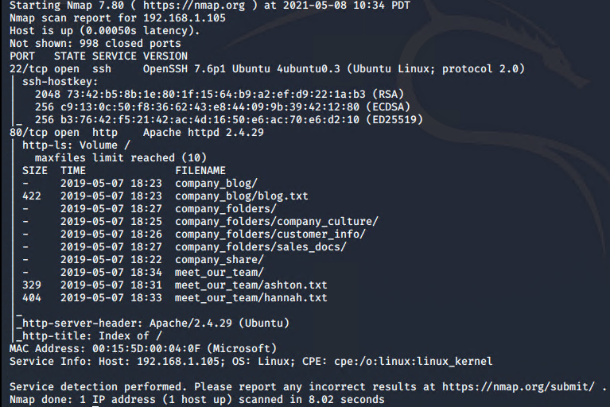
Exploitation: Open Web Port
01
02
03
Tools & Processes
I ran an nmap scan to look for any open ports on the target’s machine.
Achievements
Nmap scan returned with:
1 Host up
998 closed ports
2 ports open
Port 22
Port 80
The open web port (port 80) allowed me to gain access to the secret folders.

Slide 11
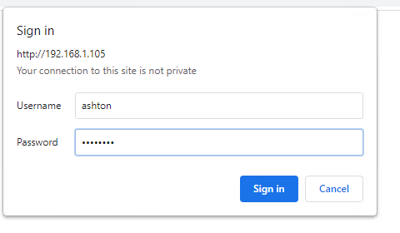
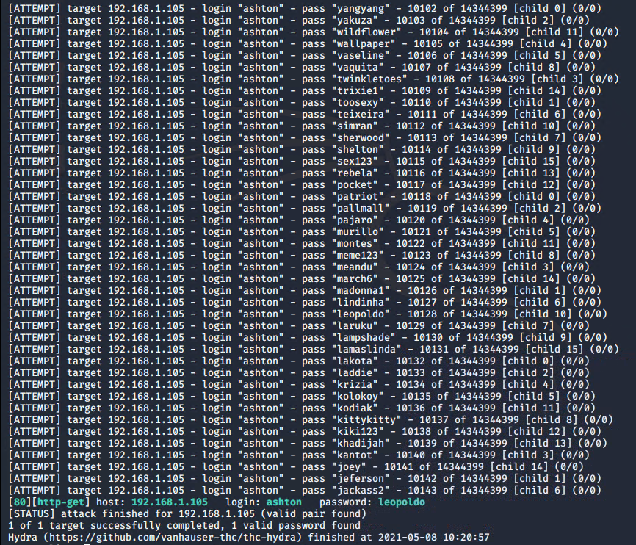
Exploitation: Brute Force Password
01
02
03
Tools & Processes
I used Hydra with a password list. The rockyou.txt password list that was easy to find with the command below.
Hydra Command:
$ hydra -l ashton -P /root/Downloads/rockyou.txt -s 80 -f 192.168.1.105 http-get /company_folders/secret_folder
Achievements
The exploit granted me access into ashton’s account, giving me the username and password with the hash for another user’s password.

Slide 12
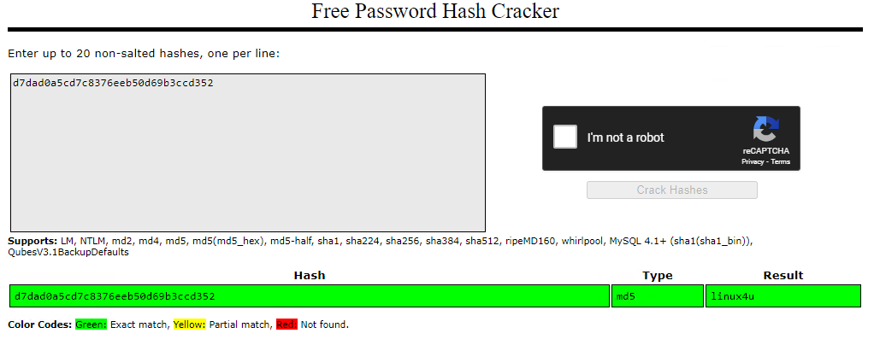
Exploitation: Hashed Password
01
02
Tools & Processes
I utilized an online tool (crackstation.net) to crack the password.
Achievements
I was able to get the user’s (Ryan) password and gain access to the webdav folder.
03

Slide 13
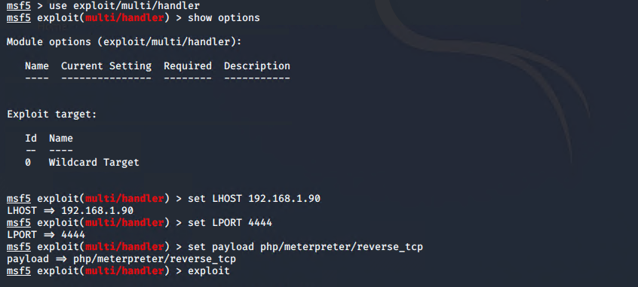
Exploitation: LFI Vulnerability
01
02
Tools & Processes
I used msfvenom and a meterpreter shell to deliver a payload onto the target’s machine.
Achievements
With the multi/handler exploit in metasploit, I was able to remotely access the target machines shell.
03

Slide 14

Blue Team
Log Analysis and Attack Characterization
‹#›

Slide 15

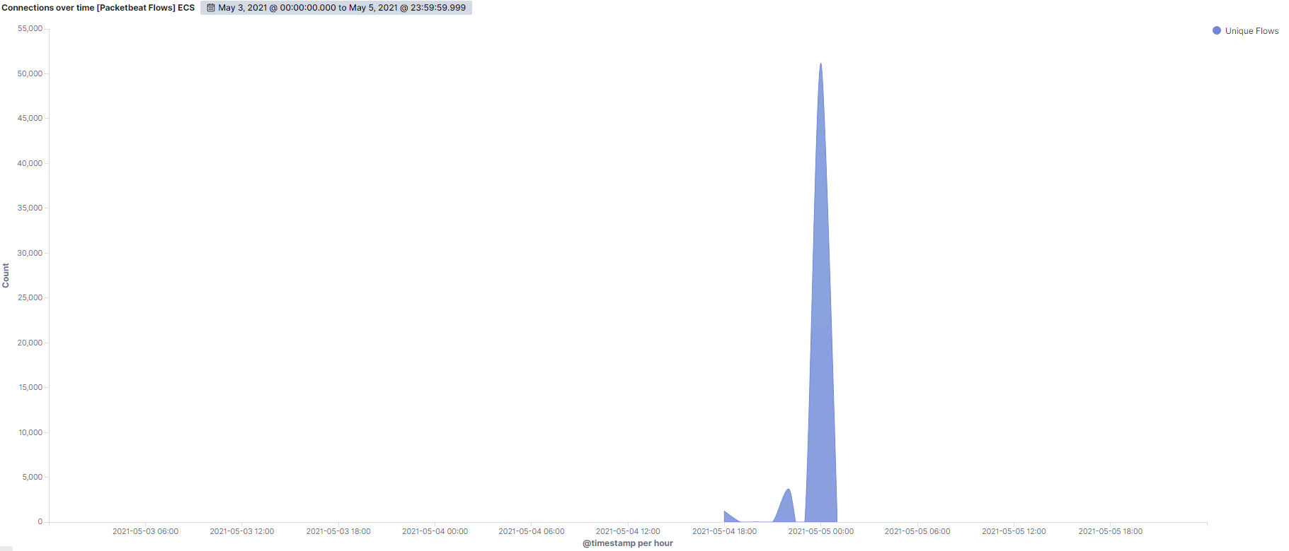
Analysis: Identifying the Port Scan
Network scan began on May 04, 2021 at approximately 22:00 hrs.
There were 51,185 connections at peak with the source IP of 192.168.1.90.
The sudden spikes and fluctuations indicates this was a port scan.
[Insert Here]
Include a screenshot of Kibana logs depicting the port scan.

Slide 16
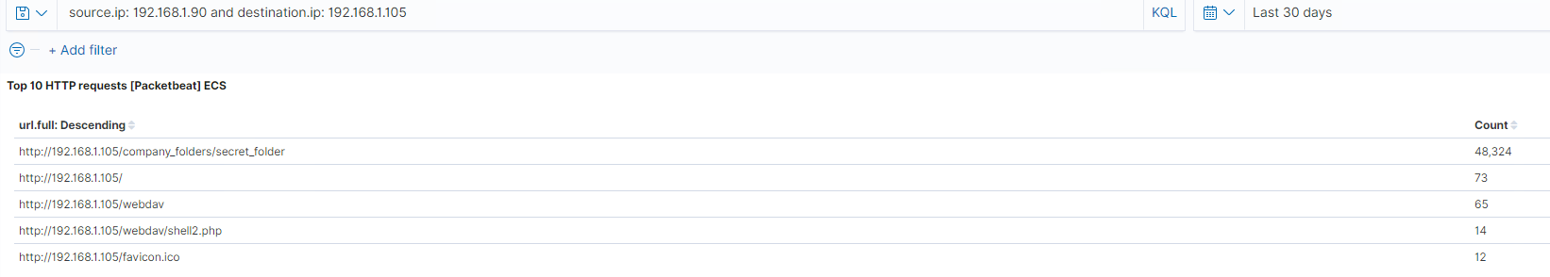
Analysis: Finding the Request for the Hidden Directory
Web requests began at 18:00 hours on 05/04/2021
Approximately 48,324 requests were made to the company secret folder
Secret folder contained the password hash for Ryan’s account
This folder also allowed the attacker to deliver a meterpreter shell payload
[Insert Here]
Include a screenshot of Kibana logs depicting the request for the hidden directory.

Slide 17
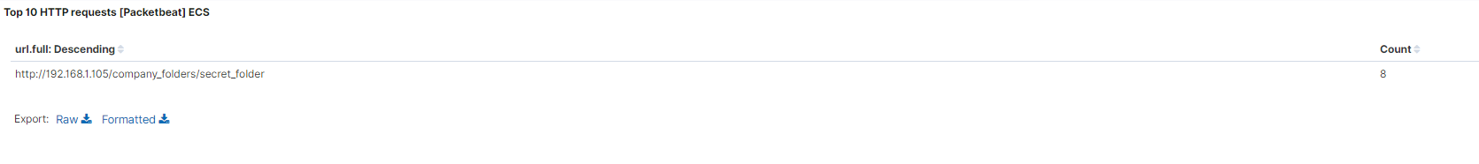
Analysis: Uncovering the Brute Force Attack
About 48,324 requests were made to access the secret folder
Only 8 attacks were successful
[Insert Here]
Include a screenshot of Kibana logs depicting the brute force attack.

Slide 18
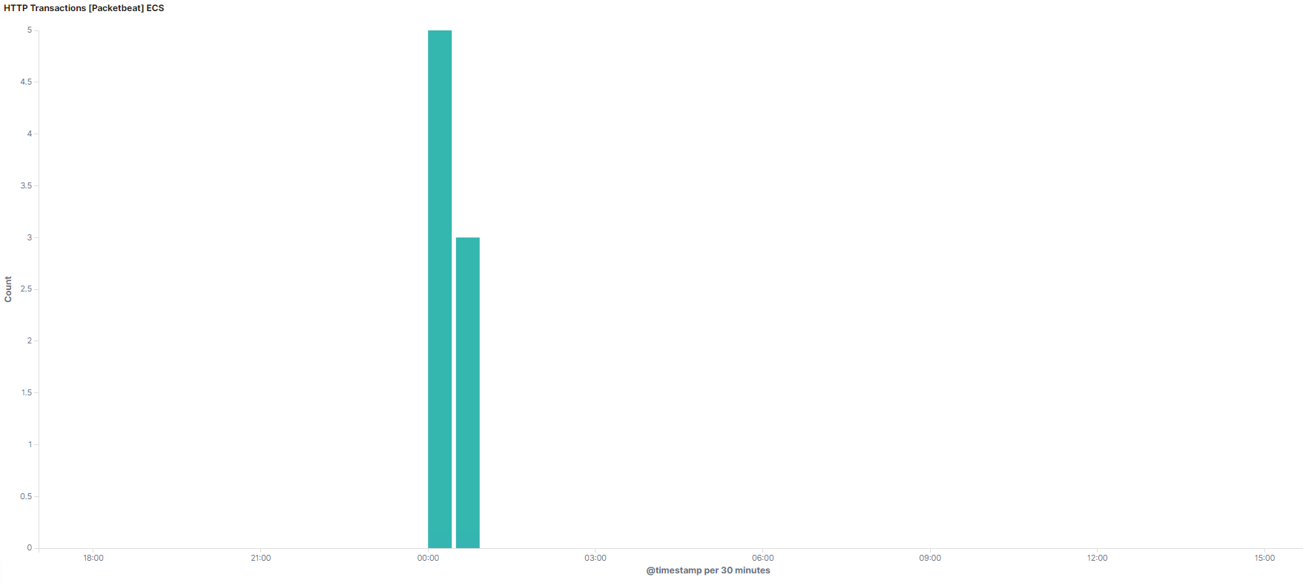
Analysis: Finding the WebDAV Connection
96 requests for the webdav folder
Most requests were for the shell.php and passwd.dav files
.

Slide 19
Blue Team
Proposed Alarms and Mitigation Strategies
‹#›

Slide 20
Mitigation: Blocking the Port Scan
Alert can be set for over 5000 connections per hour
Ensure that firewalls are properly maintained and configured.
Configure firewall to detect and filter out unauthorized scans.
Run network and system scans to detect any unfiltered ports.

Slide 21
Mitigation: Finding the Request for the Hidden Directory
Set alerts for unauthorized access requests to confidential folders.
Threshold of no more than 8 attempts per hour.
Encrypt files with confidential information.
Restrict public access to confidential files.
Limit the sharing of these confidential folders.

Slide 22
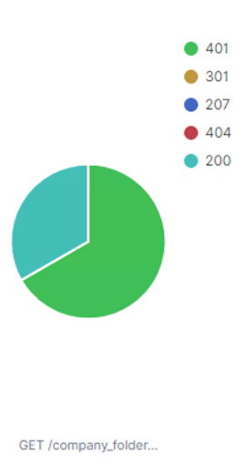
Mitigation: Preventing Brute Force Attacks
Since majority of brute force attack generates 401 error, set an alarm for this error.
10 errors per hour to trigger alert.
Utilize password constraints & complexity:
Set a password policy
Lock accounts for 1 hour after several failed login attempts.
After several failed login attempts in one day, blacklist IP addresses.
If an IP address is an employee’s, they will be removed from the list.

Slide 23
Mitigation: Detecting the WebDAV Connection
Obtain a list of users who need & granted access to the webdav directory.
Whitelist their IP addresses with periodic updates to the list.
Set alerts for any requests that are not whitelisted.
Set an effective password policy for users.
Whitelisting IP addresses only allows connections from trusted sources.
This limits unauthorized access.

Slide 24
Mitigation: Identifying Reverse Shell Uploads
Create alerts for any uploads into confidential folders.
Alert triggered after a few attempts.
Set alerts for traffic to port 4444.
Close all unnecessary ports.
Filter out IP addresses that are not trusted.
Ensure integrity of confidential folders by setting proper permissions & access controls.

